Slide 1
DIY LAB PROJECT OBJECT FOLLOWING ROBOT
SUBJECT CODE: DIY 17003
TEAM ID: 22
TEAM MEMBERS :
1. ISHAAN JAIN (22CS10032)
2. SURJYA SANKAR ROY(22ME10086)
3. DOSHI PRASAM ATITKUMAR (22ME10029)
4. PAKDE PUMBU (22AG30031)

Slide 2
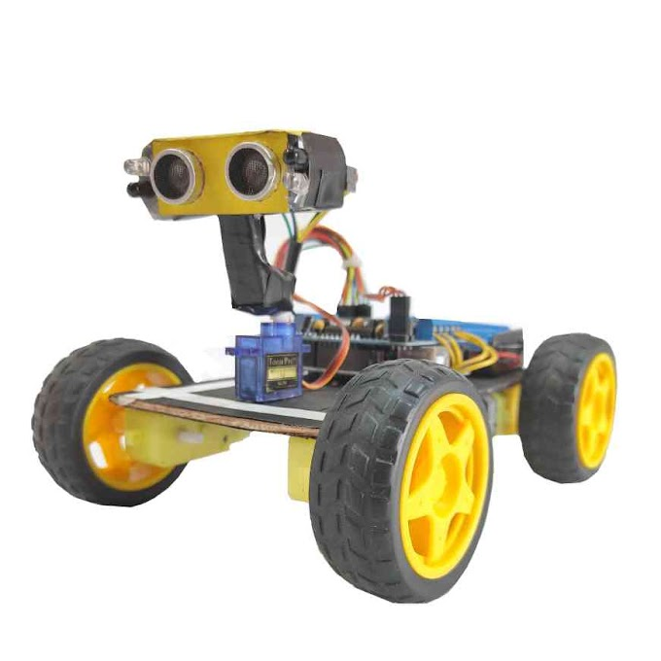
Background:
According to statistics, about $1.25 billion worth of baggage was potentially lost or stolen in 2018. It becomes especially hard for solo travelers and the impaired to lug their luggage around every day. This problem can be solved by using a ‘human following robot’ as a smart luggage trolley at an airport, or a rail or a bus station, i.e., a motor or battery-powered robot that automatically follows its “owner.” This robot can also be used as a smart cart at a department store, which follows the customer who’s using it.
Motivation:
To solve the problem of loss of luggage in crowded places and busy places by using simple technology to help the concerned people.
To explore other uses of this object-following robot and to enact further modifications on this robot for those uses.

Slide 3
Objectives:
1. To build an ‘object-following robot’ programmed to search for a nearby object and, once found, will follow it.
2. The robot uses two IR (infrared) sensors and one ultrasonic sensor. The IR sensors are used to find an object and measure its distance while the ultrasonic sensor is used to move back the robot.
3. The robot uses a servo motor to rotate the sensors to search for an object, and it runs with four DC motors. The controlling circuit of the robot is built using an Arduino UNO board.

Slide 4
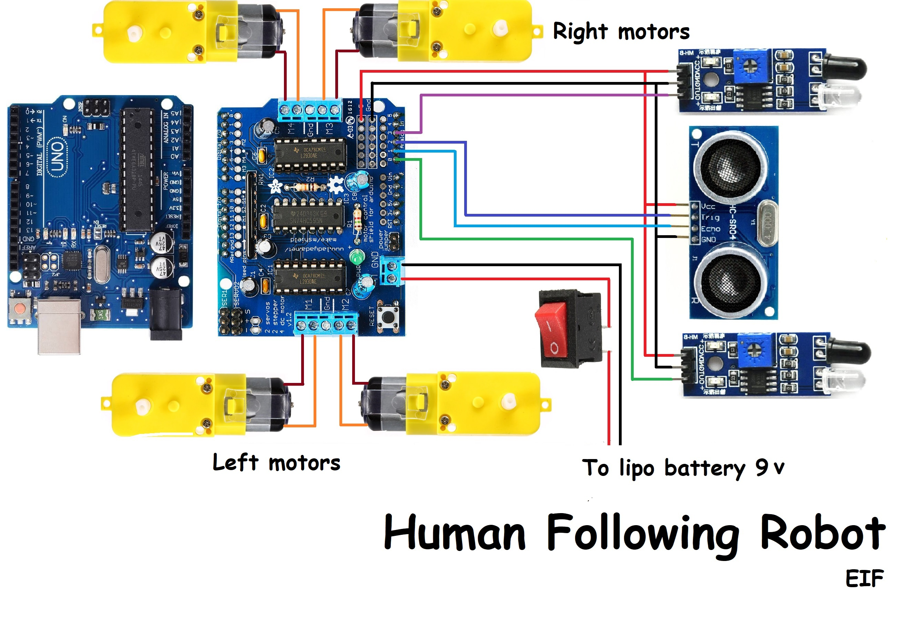
IR Transceiver
Ultrasonic sensor
Rocker Switch
Arduino UNO
Object
Motor Driver Shield
Schematic setup and their components

Slide 5
Items used:
1. Jumper wires
2. Rocker Switch, SPST
3. L293d motor driver shield
4. Wheel x4
5. BO Motor, 12V x4
6. IR Transceiver x2
7. Ultrasonic Sensor – HC-SR04
8. SG90 Micro-servo motor
9. Arduino UNO
10. Li-ion battery

Slide 6
Salient features of code
Library used in the code :
1. Servo.h: to control the servo motor using the L293D motor driver shield
2. AFMotor.h: to control the BO motor using the L293D motor driver shield
Functions used in the code:
1. read_cm() : it reads the distance using the ultrasonic sensor
2. forward(): it instructs the robot to move forward
3. backward(): it instructs the robot to move backward
4. turnRight(): it instructs the robot to turn right
5. turnLeft(): it instructs the robot to turn left
6. stop(): it stops all motor functions i.e. all wheels

Slide 7
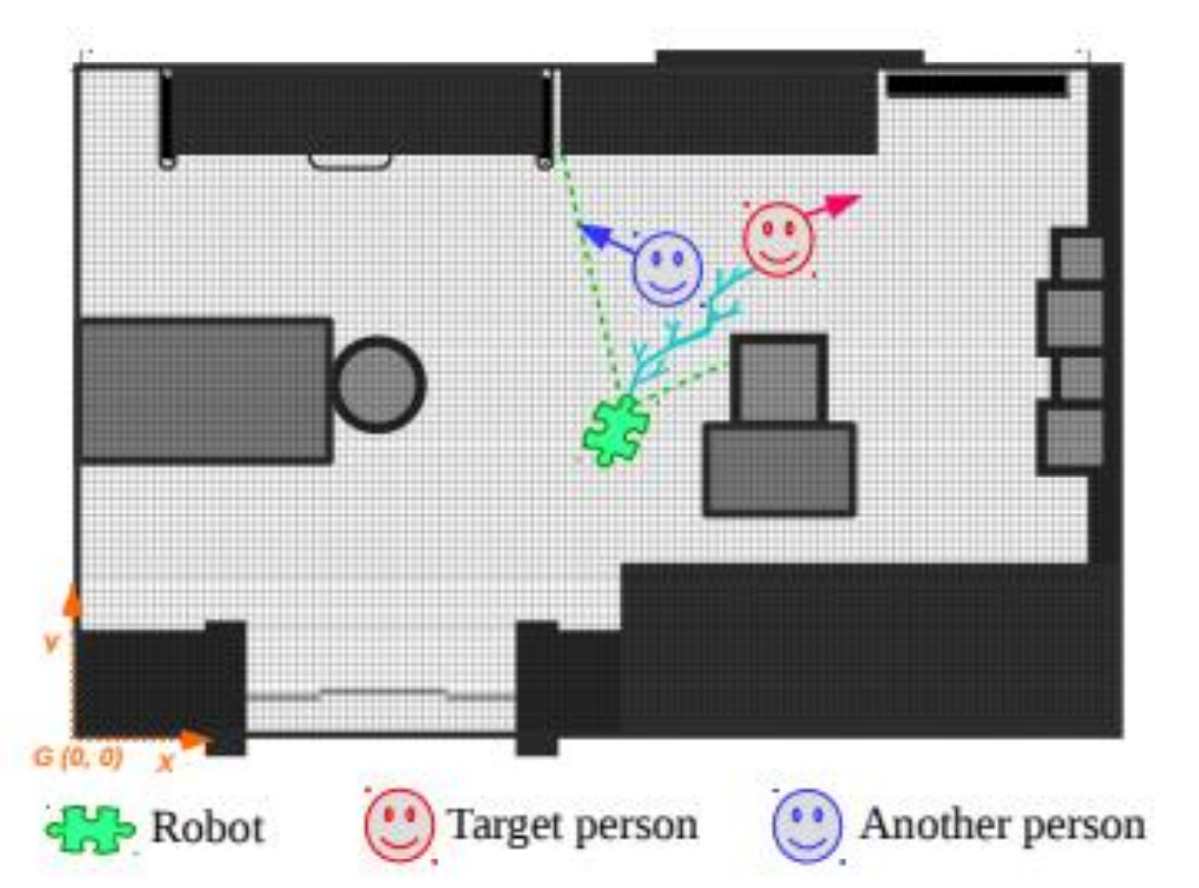
Challenges faced and Solutions found
Challenge: Suppose there are two targets like Figure, target A and target B. First, the robot is following target A, and suddenly target B passes between the robot and target A. At that time the robot will lose track of target A and detect target B. Finally, the robot will switch to follow target B instead of the original target, A.
Solution: In future work, a target-centric approach is adopted to fix the problem of a robot following two targets. This involves creating a partial map of the environment using traditional SLAM-based techniques, and then creating a 3D (depth) map of the partially observed environment to find the optimal path for person-following. Anticipatory planning, i.e., predicting where the person is going to be next and planning accordingly, can significantly alleviate this problem and is widely used in practical applications.

Slide 8
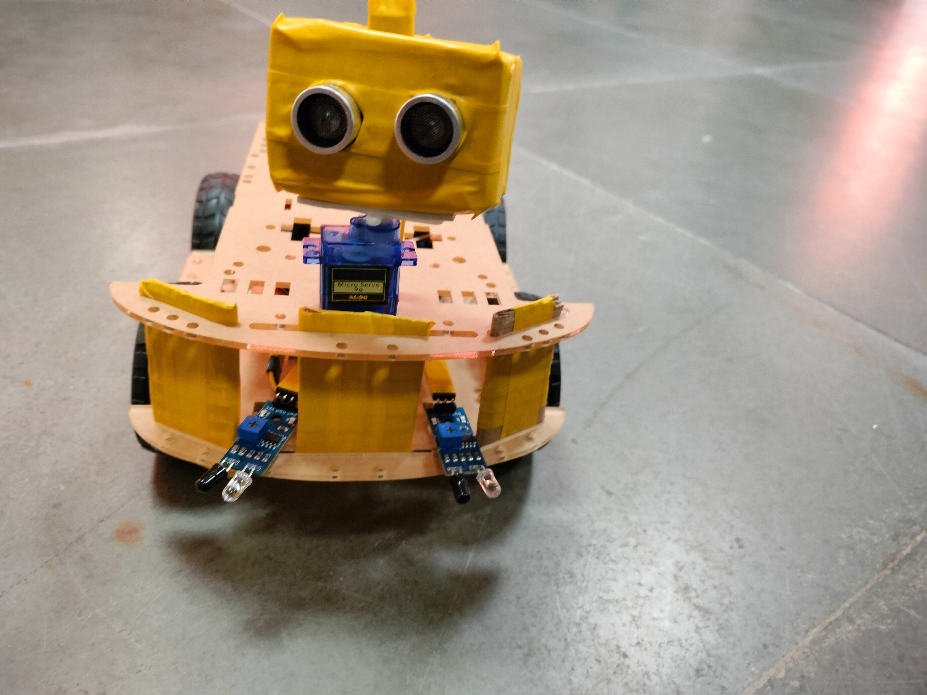
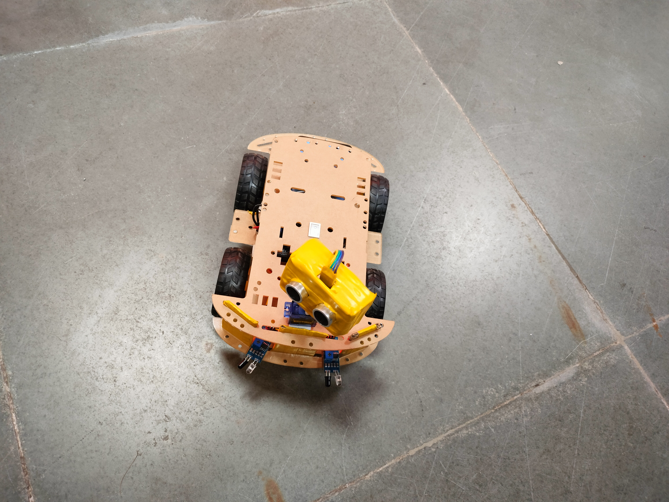
Final photographs of system

Slide 9
Learnings from the Project
Familiarity with Arduino UNO and Arduino IDE application
Circuit design and electronic components assembly
Coding and Programming for Arduino IDE
Troubleshooting and problem-solving
Project planning and presentation design.

Slide 10
Contribution of team members :
Presentation design and project report
Group Leader: Surjya Sankar Roy
Presentation design, code, and troubleshooting
Prasam Doshi
Circuit design and budget
Pakde Pumbu
Ishan Jain
Soldering and assembly-making

Slide 11
Conclusion :
This project presents a successful implementation of a prototype of a object-following robot, which has the ability to detect and follow an obstacle. It is an automobile system that has the ability to recognize obstacles, move and change its position towards the subject in the best way to remain on its track. The project used Arduino, motors, and different types of sensors to achieve its goal. It also challenged all the separate parts to cooperate with each other, communicate, and expand their understanding of electronics, mechanical systems, and their integration with programming. The devotee automated truck is accomplished utilizing ultrasonic sensor, engine drivers, and microcontrollers. This framework gives an approach in the field of advanced mechanics, which can be useful in lessening work while playing out certain assignments.
When we look closely at the environment or our surroundings, we notice the need for such robots to help and serve people. Robots like this can be used for a variety of purposes. The robot can also be used as a human companion with a few modifications. This robot's possibilities are limitless and also include assisting people in hospitals, libraries, airports, and other settings.

Slide 12
References :
https://projecthub.arduino.cc
https://www.engineersgarage.com
https://www.mathworks.com
https://www.electronicsisfun08.in/2022/
https://en.wikipedia.org/wiki/Arduino

